Slide 1

MALLA REDDY COLLEGE OF ENGINEERING & TECHNOLOGY
Department of Aeronautical Engineering
MINI PROJECT
Design And Analysis of Propulsion System of Gesture Control UAV Using AIML
Under the Guidance of Presented by: Batch No: 12
Mr. M. YUGENDER SHAIK NAWAZ (20N31A2134)
Associate Professor TIRUMALA SAI NITHIN (20N31A2135)
V.HIMABINDU (20N31A2136)

Slide 2
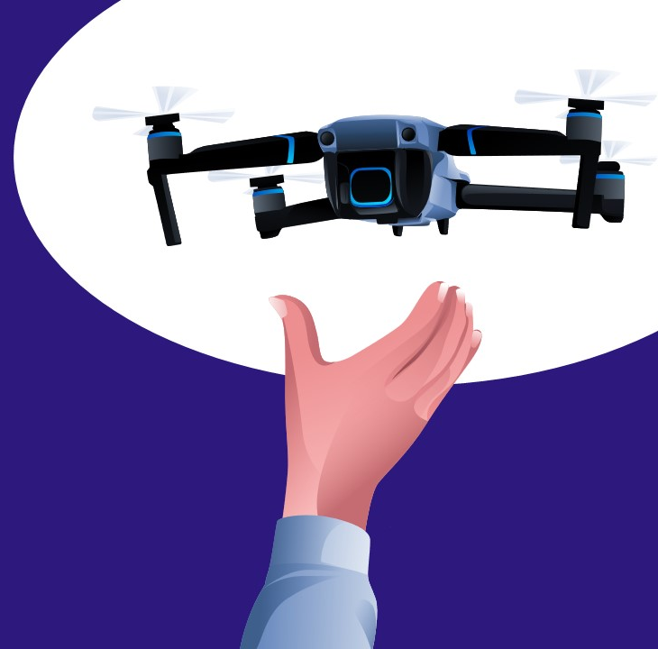
ABSTRACT
This project aims to create a Gesture Control Unmanned Aerial Vehicle (UAV) by designing a propulsion system and integrating Artificial Intelligence and Machine Learning (AIML) algorithms. With IoT components, we enable intuitive, gesture-based control, enhancing user experience and expanding the UAV's applications. The project involves optimizing propulsion technologies, implementing AIML for gesture recognition, and integrating IoT for real-time data transmission and remote control. The result is an innovative UAV with a solid foundation for future advancements in UAV technology and human-machine interaction.

Slide 3
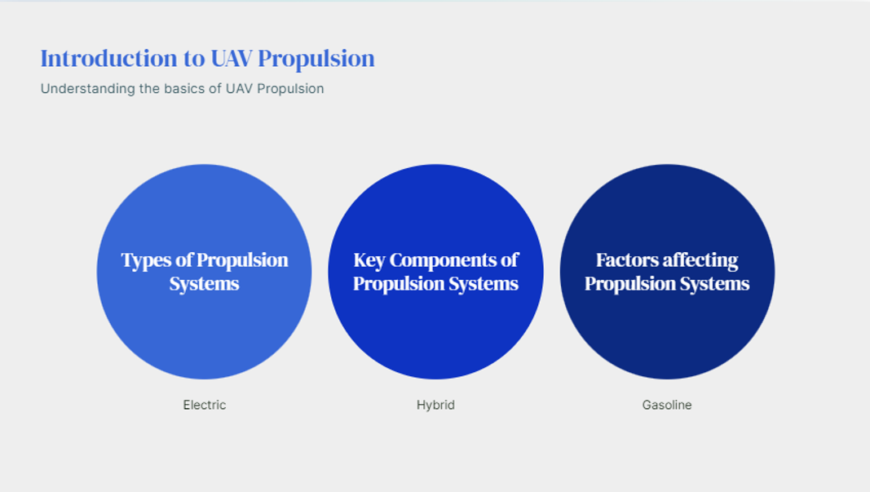

Slide 4
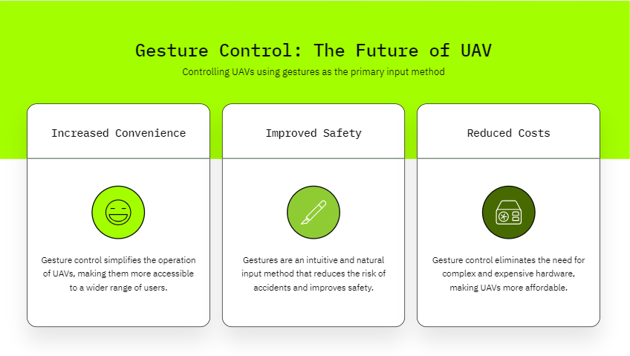

Slide 5
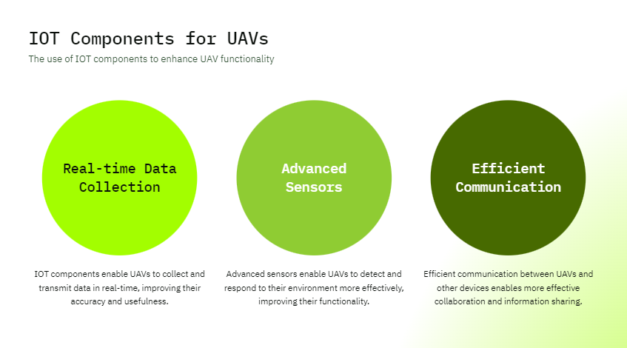

Slide 6

AIML MODEL ANALYSIS MODEL – JUPYTER NOTEBOOK
import pandas as pd
import matplotlib.pyplot as plt
# Load the data from the CSV file into a pandas DataFrame
data = pd.read_csv('drone_data.csv')
# Calculate the Thrust to Weight Ratio
data['Thrust_to_Weight_Ratio'] = data['Thrust (N)'] / data['Weight (N)']
# Calculate the Flight Time in minutes
data['Flight_Time_minutes'] = data['Flight Time (seconds)'] / 60
# Calculate the Power Consumption in Watts
data['Power_Consumption_Watts'] = data['Motor RPM (RPM)'] * data['Current Draw (Amps)']
# Calculate the Gesture Recognition System Power Consumption
data['Gesture_Recognition_Power_Consumption'] = data['Gesture Recognition Power (W)'] * data['Gesture Recognized (0/1)']
# Calculate the Total Power Consumption including Gesture Recognition System Power
data['Total_Power_Consumption_Watts'] = data['Power_Consumption_Watts'] + data['Gesture_Recognition_Power_Consumption']
# Calculate the Battery Capacity in Amp-hours
data['Battery_Capacity_AmpHours'] = data['Battery Capacity (mAh)'] / 1000
# Calculate the Battery Voltage Selection
data['Battery_Voltage_Selection'] = data['Total_Power_Consumption_Watts'] / data['Current Draw (Amps)']
# Calculate the Payload Consideration
data['Payload_Consideration'] = data['Payload Mass (kg)'] / data['Thrust (N)']
# Print the calculated values
print("Thrust to Weight Ratio:")
print(data['Thrust_to_Weight_Ratio'])
print("\nFlight Time (minutes):")
print(data['Flight_Time_minutes'])
print("\nPower Consumption (Watts):")
print(data['Power_Consumption_Watts'])
print("\nGesture Recognition System Power Consumption:")
print(data['Gesture_Recognition_Power_Consumption'])
print("\nTotal Power Consumption (Watts):")
print(data['Total_Power_Consumption_Watts'])
print("\nBattery Capacity (Amp-hours):")
print(data['Battery_Capacity_AmpHours'])
print("\nBattery Voltage Selection:")
print(data['Battery_Voltage_Selection'])
print("\nPayload Consideration:")
print(data['Payload_Consideration'])

Slide 7
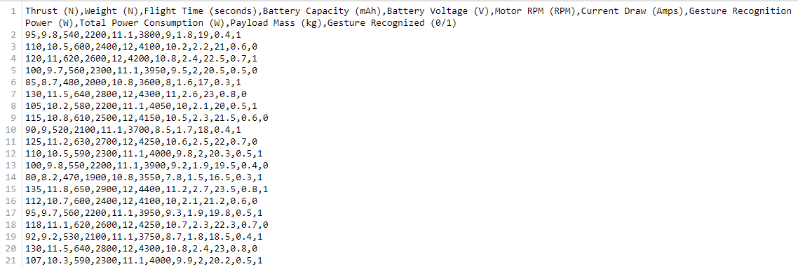
DATA USED IN THE MODEL – CSV FILE

Slide 8
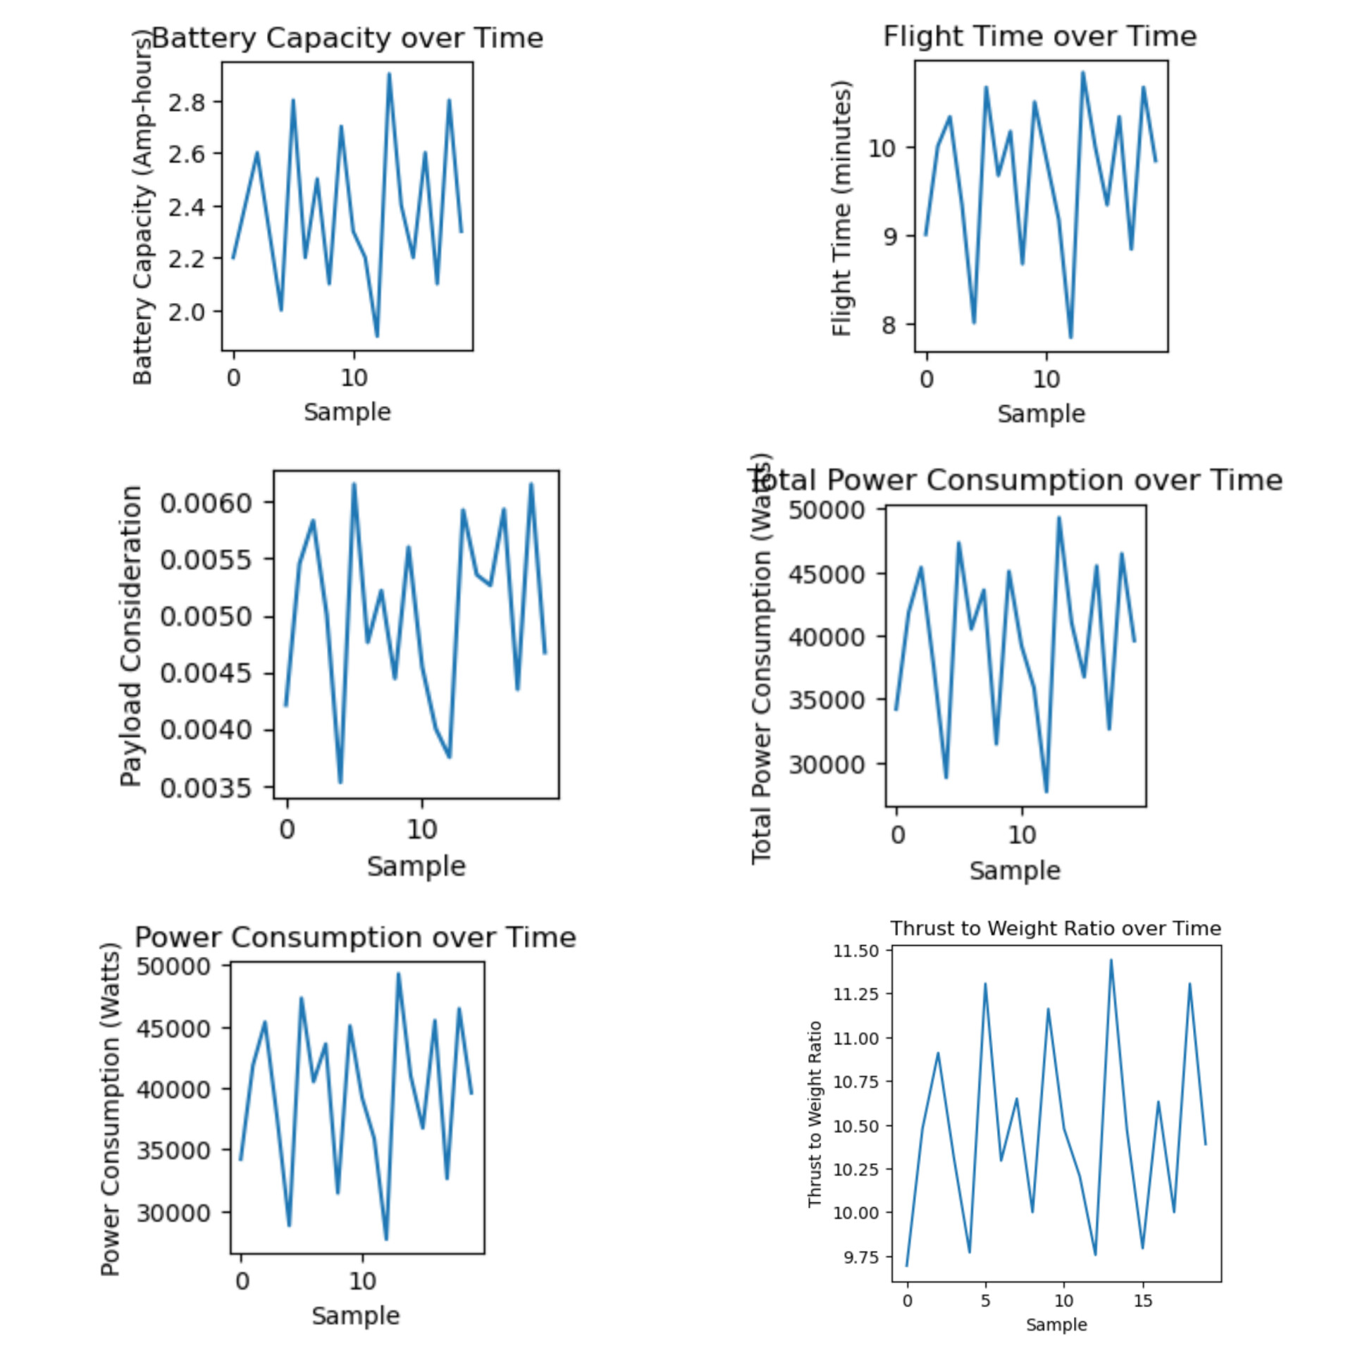
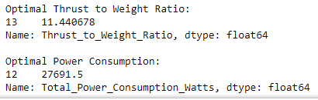
AIML MODEL OUTPUT
The output image of an AIML model for propulsion system analysis of a drone that suggests optimal values shows the following:
Optimal Thrust to Weight Ratio: 11.440678
Optimal Power Consumption: 1227691.5 Watts
The thrust to weight ratio (TWR) is a measure of how much thrust a drone's propulsion system can produce relative to its weight. A higher TWR means that the drone can accelerate faster and climb higher. The optimal TWR for a drone will depend on its intended use. For example, a racing drone will need a higher TWR than a delivery drone.
The power consumption of a drone's propulsion system is another important factor to consider. A lower power consumption means that the drone can fly for longer on a single battery charge. The optimal power consumption for a drone will also depend on its intended use. For example, a delivery drone will need to have a lower power consumption than a racing drone.

Slide 9

GESTURE CONTROL PROGRAM – ARDUINO IDE
#include <Servo.h>
// Define pin numbers for motors
int motorFrontLeftPin = 9;
int motorFrontRightPin = 10;
int motorBackLeftPin = 11;
int motorBackRightPin = 12;
// Define servo motor for camera/gimbal control
Servo cameraServo;
// Define pins for gesture control (e.g., using an IR sensor)
int gestureSensorPin = A0;
// Define obstacle detection sensor pins (e.g., ultrasonic)
int obstacleFrontPin = 2;
int obstacleBackPin = 3;
int obstacleLeftPin = 4;
int obstacleRightPin = 5;
// Variables to store sensor readings
int gestureValue;
float obstacleFrontDistance;
float obstacleBackDistance;
float obstacleLeftDistance;
float obstacleRightDistance;
void setup() {
// Initialize motor control pins as outputs
pinMode(motorFrontLeftPin, OUTPUT);
pinMode(motorFrontRightPin, OUTPUT);
pinMode(motorBackLeftPin, OUTPUT);
pinMode(motorBackRightPin, OUTPUT);
// Attach servo motor
cameraServo.attach(6);
// Initialize gesture sensor and obstacle detection sensors
pinMode(gestureSensorPin, INPUT);
pinMode(obstacleFrontPin, OUTPUT);
pinMode(obstacleBackPin, OUTPUT);
pinMode(obstacleLeftPin, OUTPUT);
pinMode(obstacleRightPin, OUTPUT);
// Initialize serial communication for debugging (optional)
Serial.begin(9600);
}
void loop() {
// Read sensor values
gestureValue = analogRead(gestureSensorPin);
obstacleFrontDistance = readObstacleSensor(obstacleFrontPin);
obstacleBackDistance = readObstacleSensor(obstacleBackPin);
obstacleLeftDistance = readObstacleSensor(obstacleLeftPin);
obstacleRightDistance = readObstacleSensor(obstacleRightPin);
// Perform gesture recognition and obstacle avoidance logic
adjustMotorsAndCamera();
// Debugging output (optional)
Serial.print("Gesture Value: ");
Serial.println(gestureValue);
Serial.print("Obstacle Front Distance: ");
Serial.println(obstacleFrontDistance);
Serial.print("Obstacle Back Distance: ");
Serial.println(obstacleBackDistance);
Serial.print("Obstacle Left Distance: ");
Serial.println(obstacleLeftDistance);
Serial.print("Obstacle Right Distance: ");
Serial.println(obstacleRightDistance);
// Delay to control loop frequency
delay(100);
}
float readObstacleSensor(int pin) {
// Measure distance using an ultrasonic sensor (HC-SR04)
digitalWrite(pin, LOW);
delayMicroseconds(2);
digitalWrite(pin, HIGH);
delayMicroseconds(10);
digitalWrite(pin, LOW);
long duration = pulseIn(pin, HIGH);
// Speed of sound in air at 20°C is approximately 343 meters per second
// Divide by 2 to account for the round trip of the sound wave
float distance = duration * 0.0343 / 2;
return distance;
}
void adjustMotorsAndCamera() {
// Implement your gesture recognition, obstacle avoidance, and motor control here
// You can use the sensor readings and gestures to adjust motor speeds and cameraServo position.
// For example, you can check obstacle distances and adjust motor speeds to avoid obstacles.
// You can also control the camera servo based on gestureValue to adjust the camera or gimbal.
// Example: Adjust the front left motor speed based on the front obstacle distance
if (obstacleFrontDistance < 20) {
// If an obstacle is too close, reduce the motor speed or stop the motor
analogWrite(motorFrontLeftPin, 0);
} else {
// Otherwise, set the motor speed to a normal value
analogWrite(motorFrontLeftPin, 255);
}
// Example: Control the camera servo based on gesture value
int cameraAngle = map(gestureValue, 0, 1023, 0, 180);
cameraServo.write(cameraAngle);
}
// Implement your gesture recognition, obstacle avoidance, and motor control functions here

Slide 10
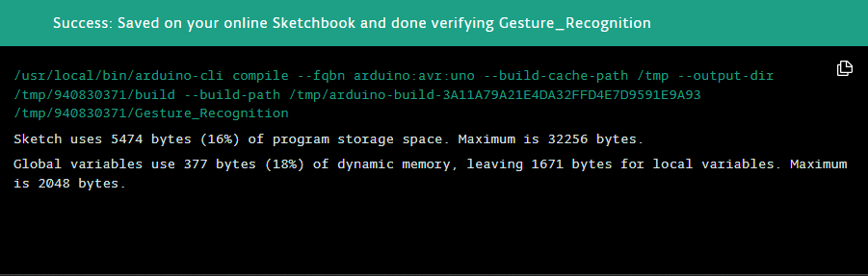
GESTURE CONTROL PROGRAM – OUTPUT
This Arduino code is designed for a drone with gesture recognition, obstacle avoidance, and camera control features. It reads sensor values from an IR gesture sensor and ultrasonic obstacle sensors, adjusts motor speeds, and controls a camera servo based on the input. If an obstacle is detected within 20 centimeters in front, it stops the front left motor. The camera angle is adjusted based on the gesture value. You can further customize the code for your specific drone's behavior.
Successful execution of this code enables the drone to respond to gestures, avoid obstacles, and control the camera or gimbal position.

Slide 11
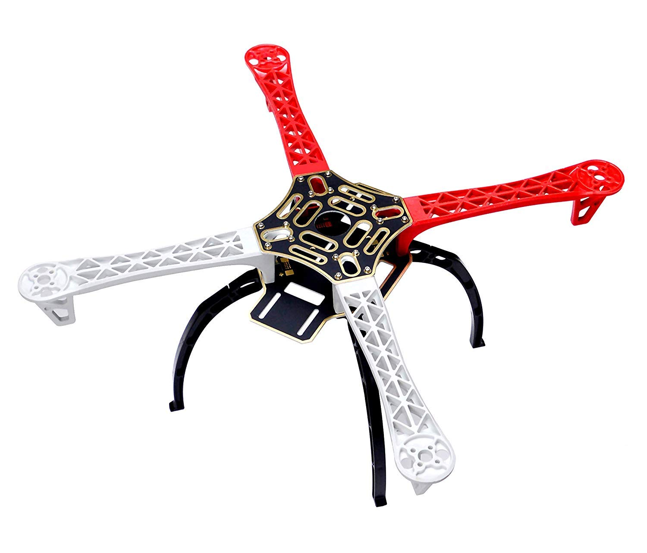
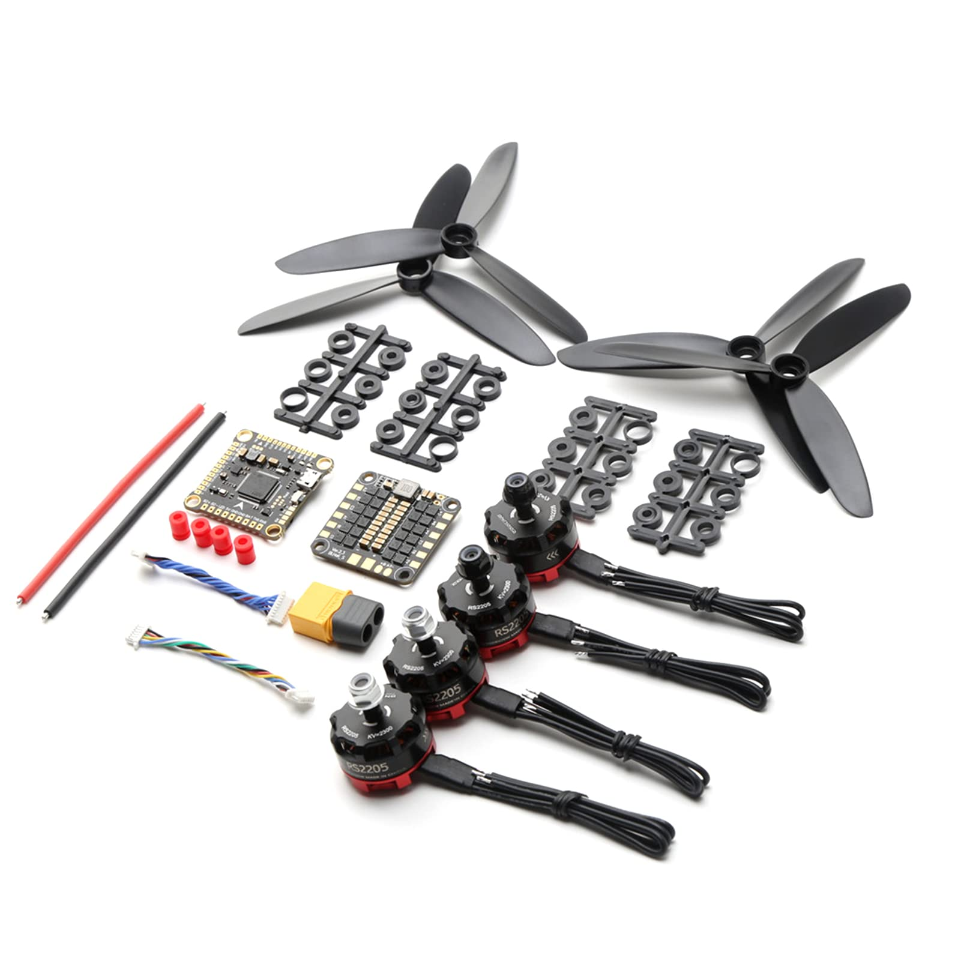
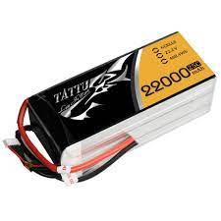
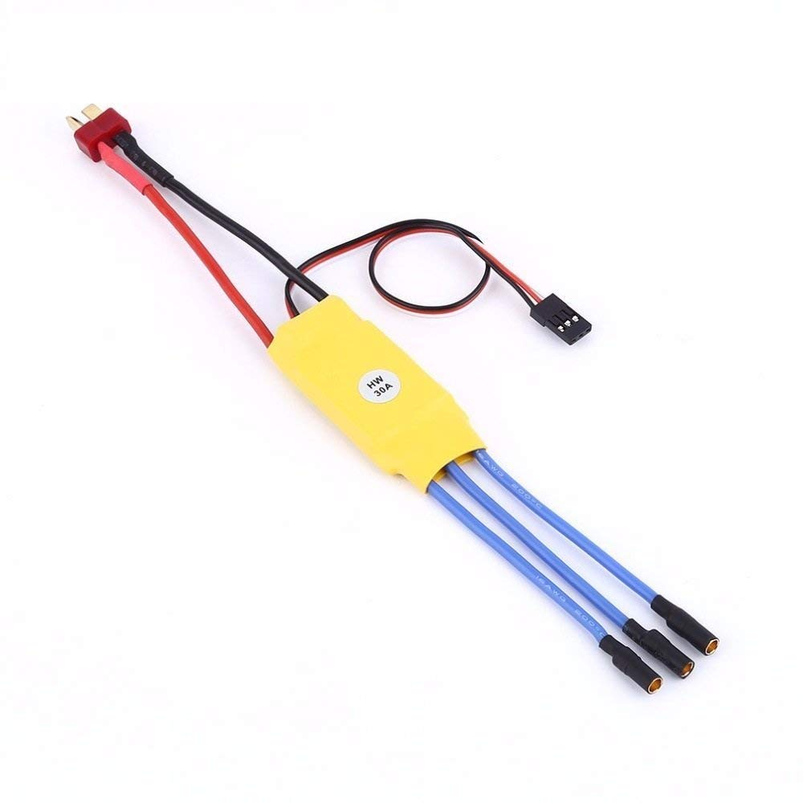
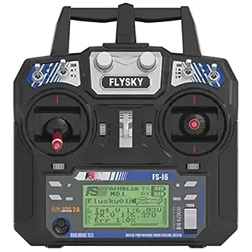
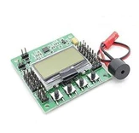
PARTS TO BE USED
Motors, Propellers, Wires.
Battery
ESC
Drone Frame
Flight Controller
Radio Controller

Slide 12
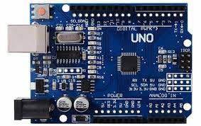
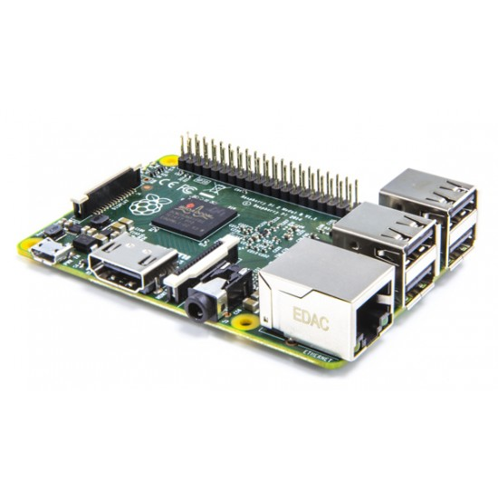
IOT COMPONENTS USED
ARDUINO BOARD
RASPERRY PI

Slide 13
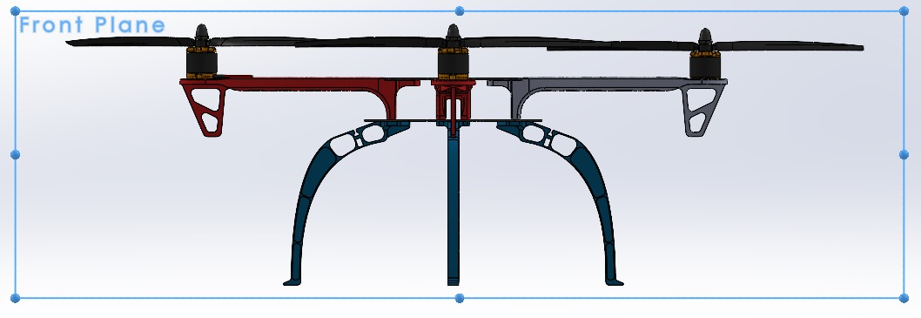
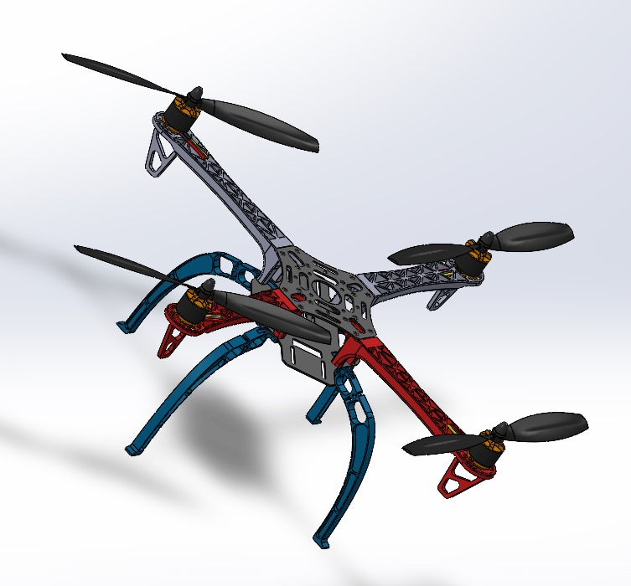
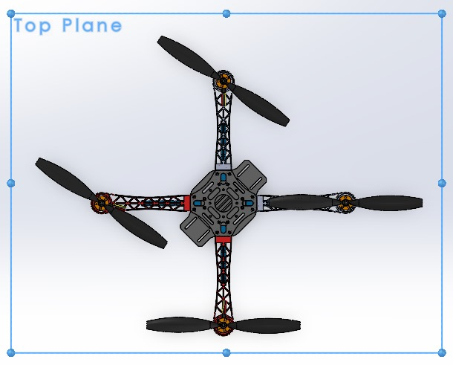
DRONE DESIGN VIEWS – SOLIDWORKS

Slide 14
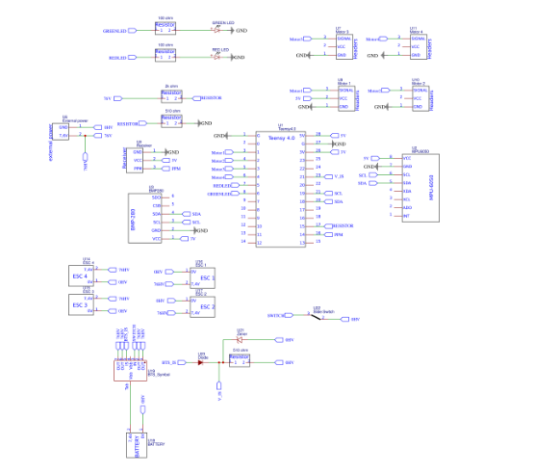
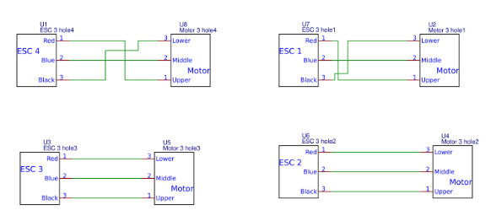
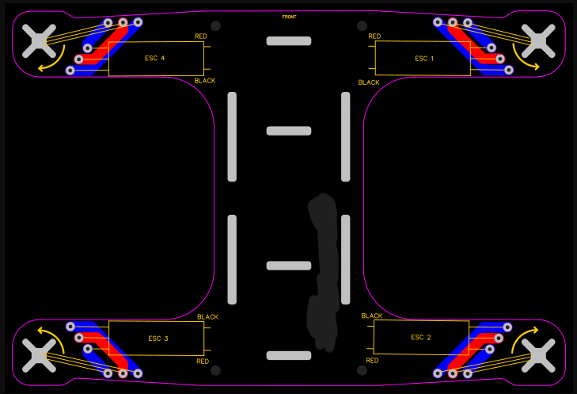
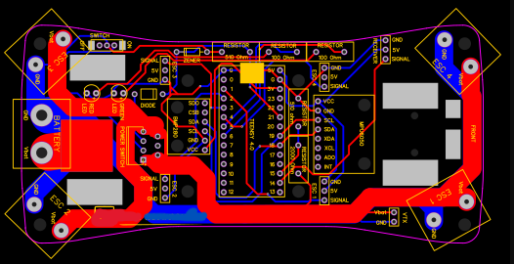
DRONE BASIC CIRCUIT DESIGNS - CONNECTIONS
LOWER DRONE FRAME
UPPER DRONE FRAME
LOWER DRONE FRAME – PCB
UPPER DRONE FRAME – PCB

Slide 15
MANUAL CALCULATIONS
Weight = 1000g
Discharge = 80%
Capacity of battery = 2200 mAh
Lift = 10N (Measured using Thrust stand.
Velocity = 10m/s (measured with GPS module / flight Controller)
No. of motors = 4
KV Rating = 4000 RPM
Air density = 1.225 = 1+225 kg/m³ (measured with barometer) Area = 100 cm²
Power output = 201 Power Input = 3044
Weight of payload= 100g. = Power required of payload = 10W.
Propeller pitch = 5inch
Amm length = 20cm.
Total mass of drone = 1000g
Battery voltage = 11.1 Volts.
Thrust to weight of drone is 2:1
Total thrust Required = Total weight x TWIR
= 1000 × 2:1
Total Thrust Required. = [2000g]
Thrust per motor = Total Thrust Required/ No. of motors = 2000/ 4
Thrust per motor = 500g
Motor – RPM = (voltage x kv) / propeller pitch.
Propeller pitch = Distance between Leading edge to Trailing edge of propeller blade
Motor RPM = (11.1 x 4000)/ 5
= 8880 RPM
i.e., Motor RPM = 929.44 rad/s.
Flight time = Battery Capacity X Discharge/ AAD
Average Ampere Draw (AAD) = Power/ Voltage
Power Required = (Thrust x TWR)/ (motor efficiency x 2)
efficiency of motor and propellers = (Power input output)/ (Power Input)
= 20W/ 30W
efficiency of motor & propellers = 66.67%
Power Required = (2000 x 2)/ (66.67% X2)
Power Required = 3000W
Drone weight = 724g
Battery weight = 26g
Equipment weight = 250g
Total weight = 1,000 g
Thrust-to-weight ratio = 2:1
Number of motors = 4
Total thrust = 2,000g
Thrust per motor = 500g
Average Ampere Draw (AAD) = Power/ voltage = 3000/ 11.1
AAD = 270.2 A
Flight time = (Battery Capacity * Discharge)/ AAD = (2200mAh x 80%)/ 270.2A
Flight time = 6.5 min
Battery weight = (flight time x payload)/ Battery energy density = (6.5mX 1000g)/ 250 (Wh/kg)
Battery weight = 26g

Slide 16
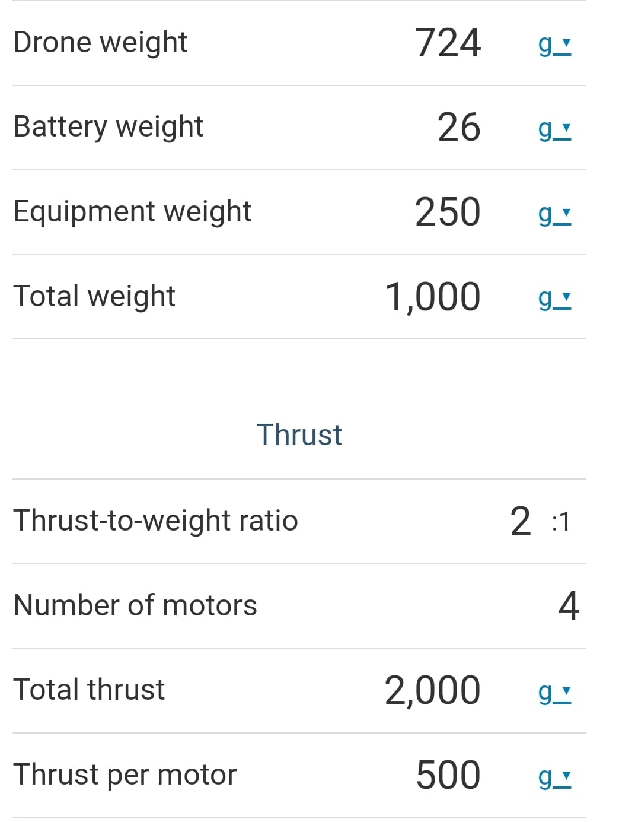
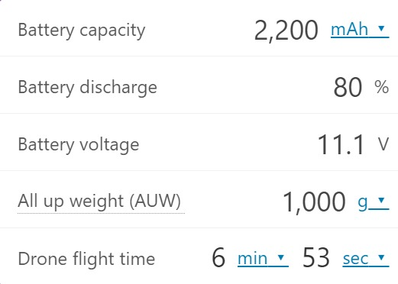
DRONE MOTOR CALCULATOR & FLIGHT TIME CALCULATOR OUTPUTS

Slide 17
MANUAL CALCULATIONS
Battery capacity = 2,200 mAh
Battery discharge = 80%
Battery voltage = 11.1 v
All up weight (AUW) = 1,000 g
Drone flight time = 6 min▾53 sec
Range = (Flight time x Airspeed)
Airspeed = [(Dynamic Pressure (Pa))/ (Air density (kg/m³))]^(1/2)
Dynamic pressure = ½(Sv²)
S = air density. i.e., 1.225 kg/m^3
V= velocity
Dynamic pressure = (1/2) x (1.225x (10)²) = 61.25 pa
Air speed = (61.25/ 1.225)^(1/2) = 6.38 m/s
Range = 6.5 x 6.38
Range = 41.47m
current drawn = [(Power required)/ Voltage] x (efficiency of drone)
Where,
Efficiency of Drone = Thrust/ Power Consumption
Power consumption = (weight of drone x lift coefficient)/ (efficiency of motors & propellers)
Efficiency of motors and propellers = 66.67 %
weight of drone ie., Total weight = 722g
Lift coefficient = Lift/ [(0.5) x Air density x V² x Area]
Lift Coefficient = (Lift)/ [(0.5) x 1.225 x (10)² x 100]
Lift Coefficient = 1.63
Power consumption = (722 x 1.63) / 66.67%
Power Consumption = 17.6 W
Payload power Consumption = (Weight of Payload) x (power requirement of the pay load)
Where,
weight of payload = 250 g
Power required of the payload = 10W
Payload power Consumption = 250g x 10w.
PPC = 2.5W
Total power consumption = Power Consumption + Payload power consumption
= 17.6W + 2.5 W
Total power Consumption = 20.1 W
Efficiency of Drone = Thrust/ power Consumption
Where,
Thrust = 2000g
Power consumption i.e., Total power consumption is = 20.1W
Efficiency of Drone = 2000g/ 20.1W = 99.5 = 0.995 %.
Now,
Current drawn = (Power Required/ voltage) x (efficiency of drone)
= (3000W/ 11.1V) X 0.995%
current drawn = 2.6 A
Gesture Recognition System power Consumption = P Camera + P- processor + P. Software
= 0.5W + 1.5W + 1W
GRS power Consumption = 3W.

Slide 18
MANUAL CALCULATIONS
Payload mass = (Total weight of a drone) – (Drone weight) – (battery weight) – (Other
Components weight)
Where ,
Total weight = 1000g
Drone weight = 722g.
battery weight = 26g
other components weight = 100g
Payload mass = 1000 – 722 – 26 – 100
Payload mass = 78 g
Hence :-
Total weight = 1000g
Flight time = 6.5min
Batter capacity = 2200 mAh
Battery voltage = 11.1v
Motor RPM = 8880 RPM/ 929.44 rad/s
Discharge = 80%
Current drawn = 2.6 A
Gesture Recognition System power = 3W
Total power Consumption = 20.1W
Payload Mass = 78g

Slide 19
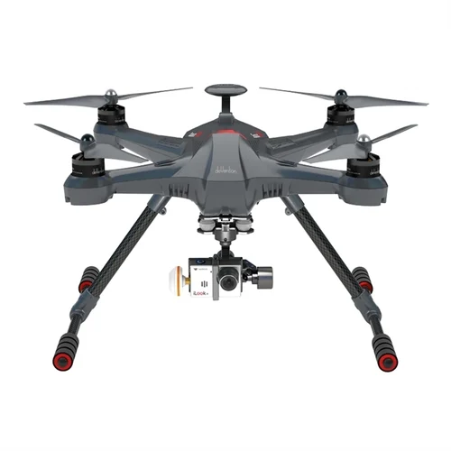
CONCLUSION
In conclusion, our project has successfully transformed traditional UAVs into intuitive, responsive, and user-friendly machines. We've designed an optimized propulsion system, implemented AIML algorithms for gesture control, and integrated IoT components. The result is an innovative Gesture Control UAV with vast potential for user experience enhancement and diverse applications, paving the way for future UAV technology and human-machine interaction advancements.

Slide 20
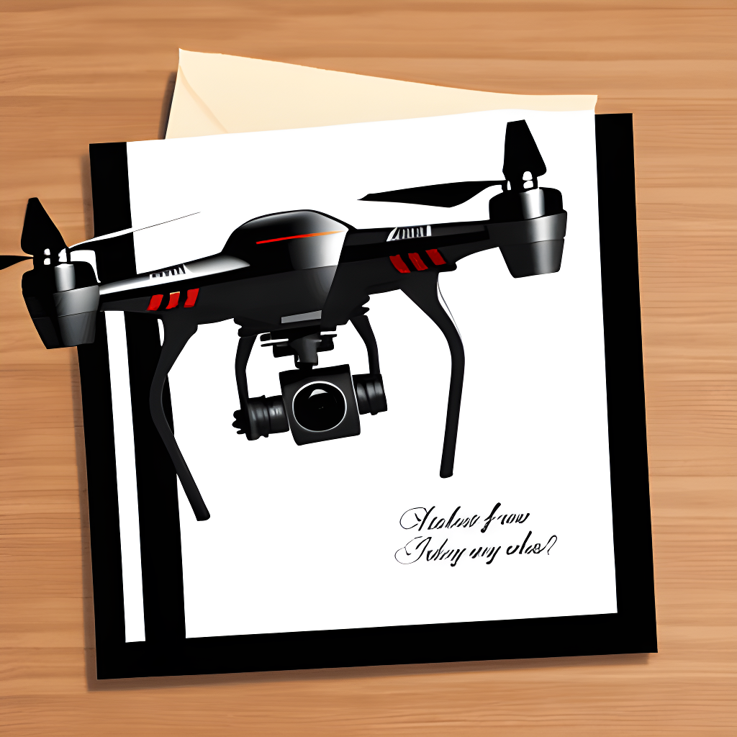
THANK YOU

